Slide 1
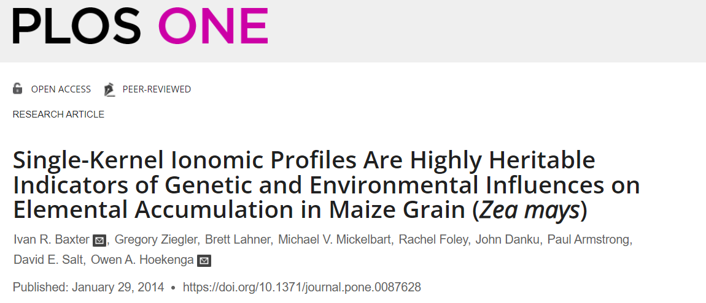
EEOB 546 Final
May 3, 2024
Group members: Russell Greene, Tae-Chun Park, Sharmista Goswami, Panchali Chakraborty, Maliha Jahan, Kiara Kappelmann

Slide 2
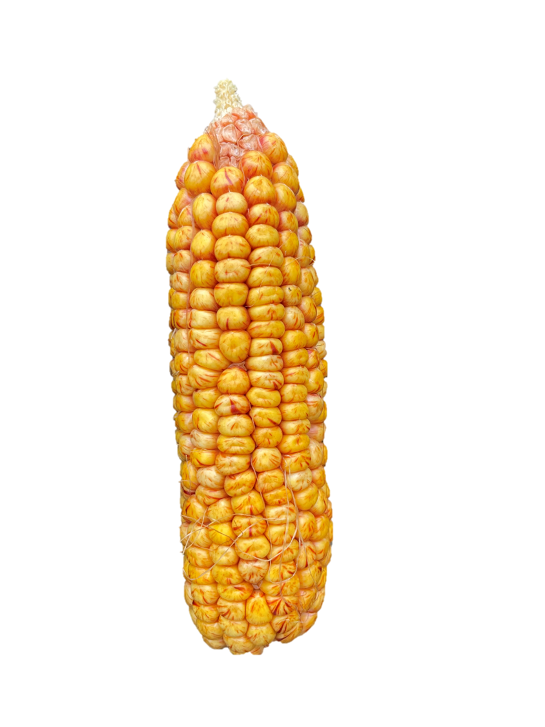
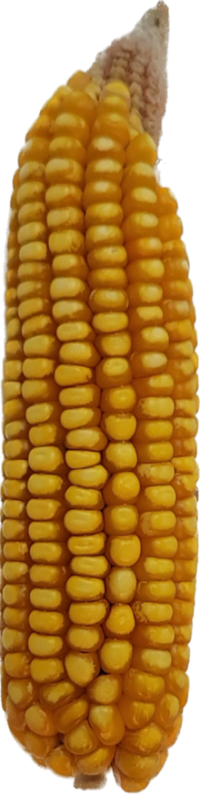

Background
Ionomics study: elemental composition
Scientific question: Is a single maize kernel adequate to sample the ionome of a plant? What about P = G + E + GxE ?
Methods: Used NAM founders grown in two environments and sampled kernels from each line+environment combination. All computations performed in R
Outcomes
Dissected G, E, GxE of mineral concentrations
Differentiated impact of kernel location on cob
Assessed genotypic effect on human-consumed lines (sugary)
QTL detection for mineral concentrations
Environment 1
Environment 2

Slide 3

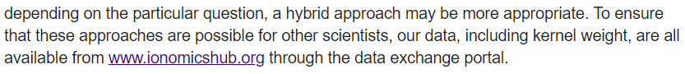
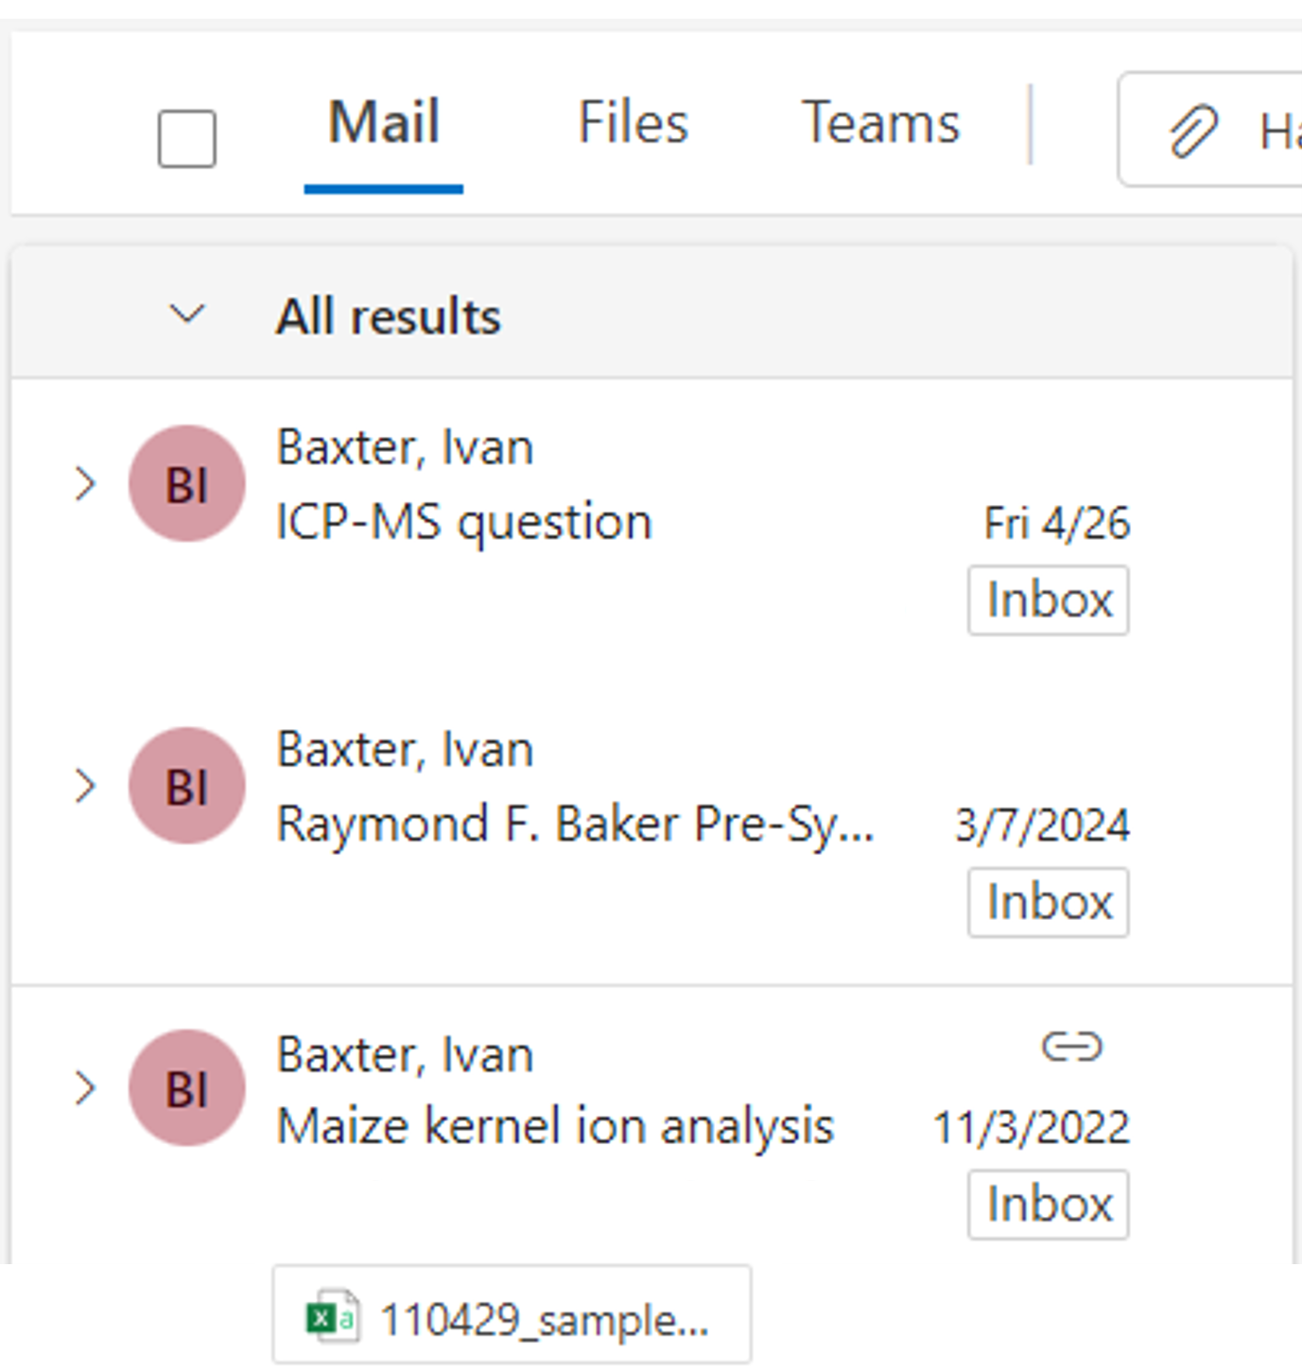



Data (un)availability?
Sent raw files from Plos 2014 paper

Slide 4
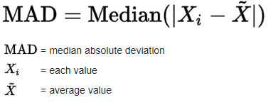
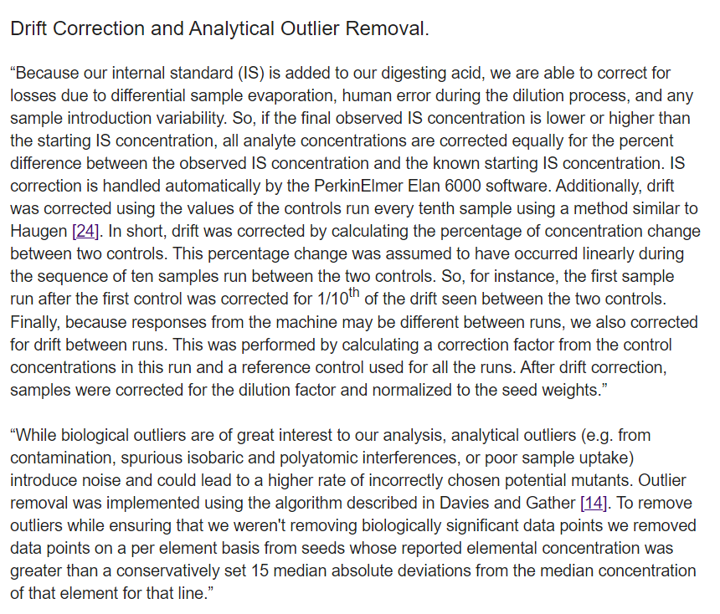
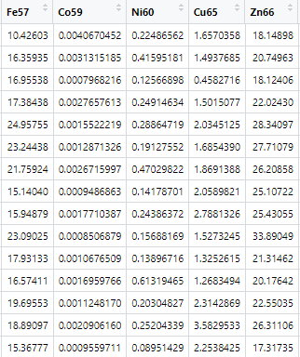
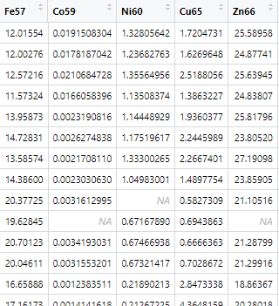
Outlier removal
Derived MAD value for dataset
Looped through all data columns using MAD value as cutoff and replacing outliers with "NA"

Slide 5
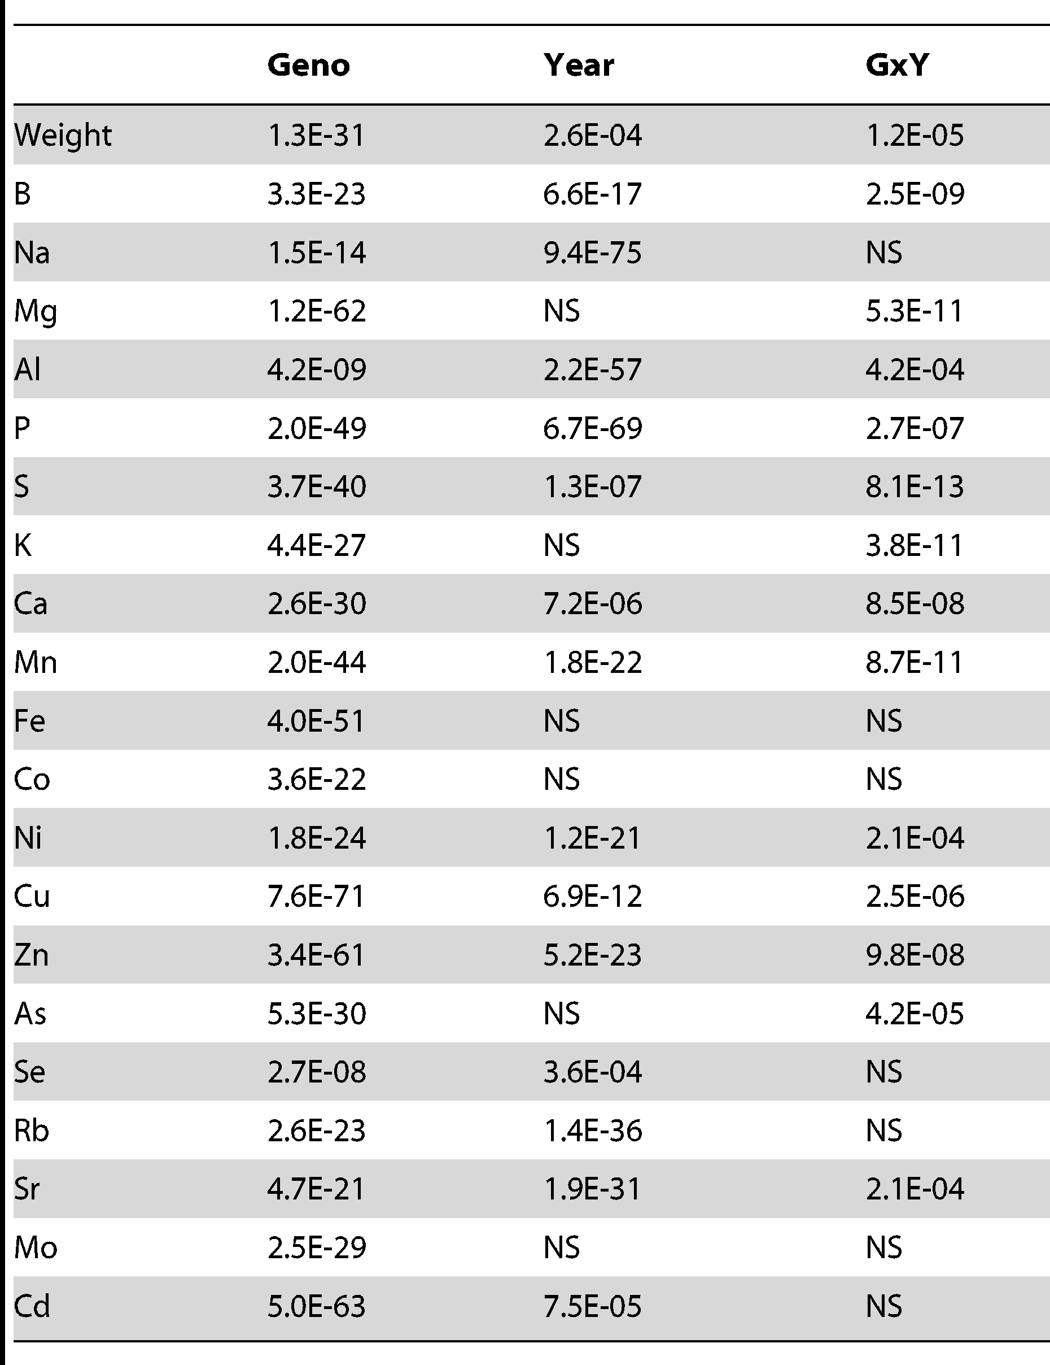
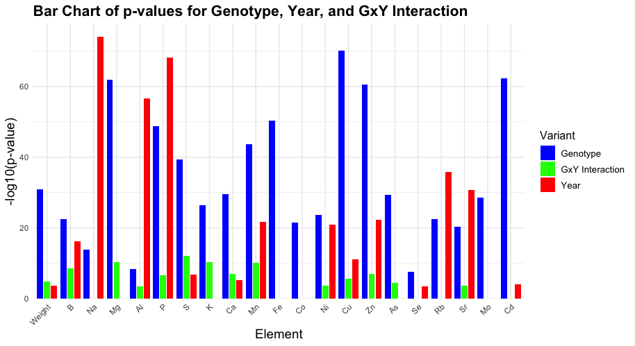
Analysis of the NAM founders ionomic profiles from 2010 and 2011.
Table 1-From Paper
Bar chart for p-values for Genotype, Year and Genotype X Year interaction

Slide 6
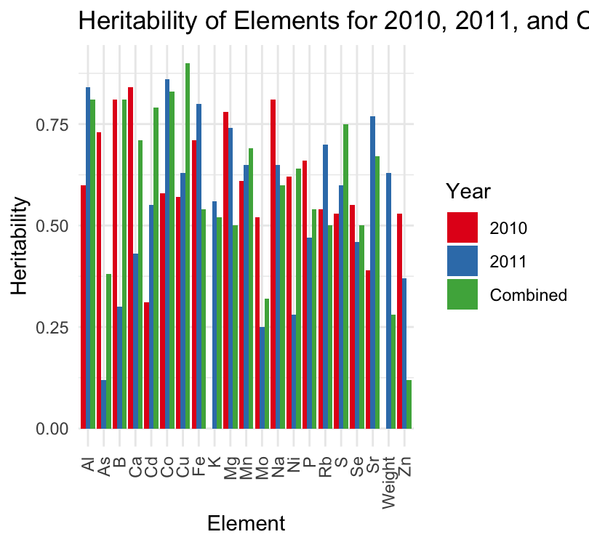
Heritability of the elements of 2010, 2011 and combined

Slide 7
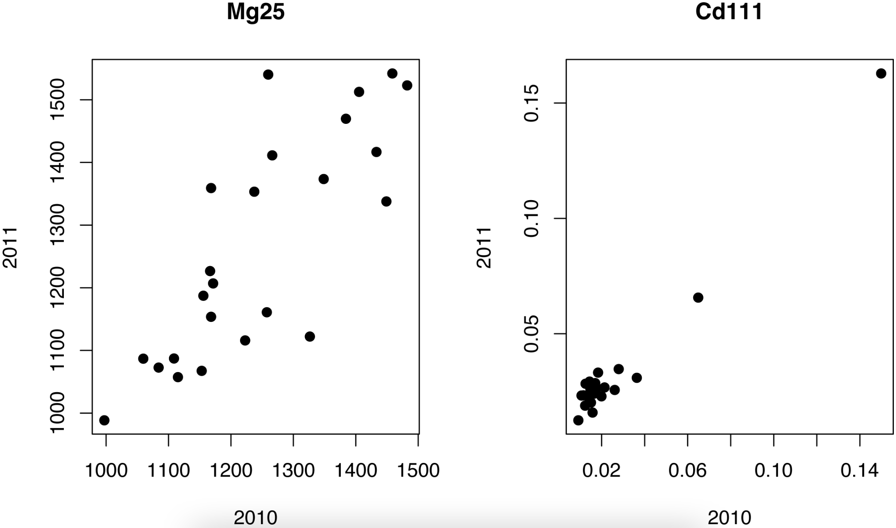
Figure 1 – Original figure
Concentrations of Mg25 and Cd111 for 23 genotypes across two sampling years
Visualization of correlation of element concentration between two sampling years

Slide 8
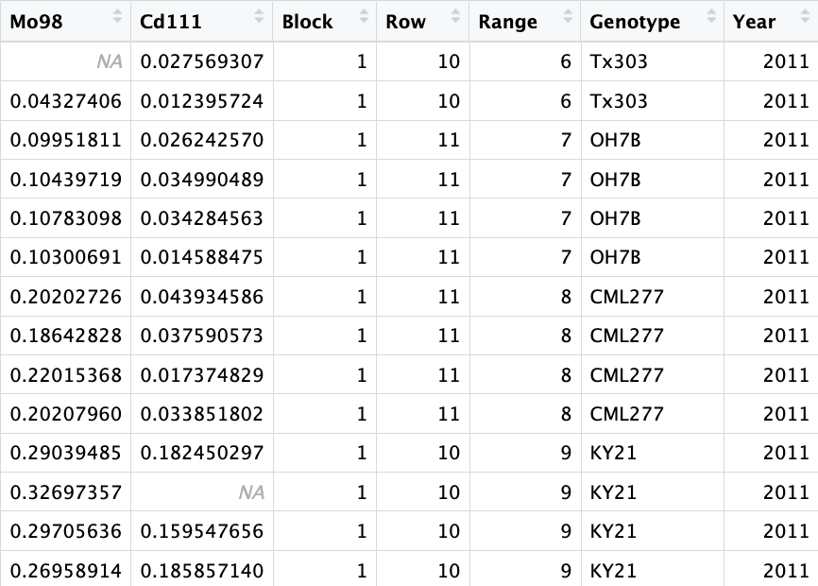
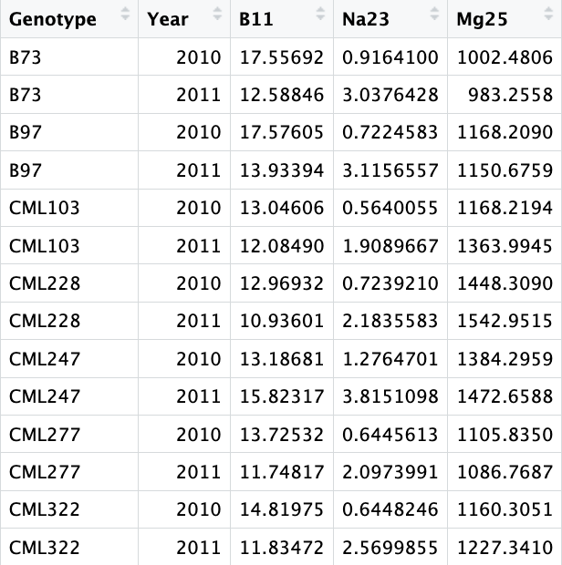

Trim data
Calculate mean
Remove genotypes
1245 rows x 27 columns
53 rows x 22 columns
Data processing

Slide 9
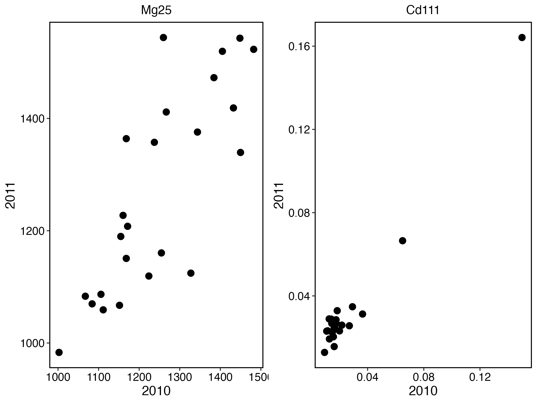
Create dfs for each element
Generate Mg25 and Cd111 plots
Combine plots

Slide 10
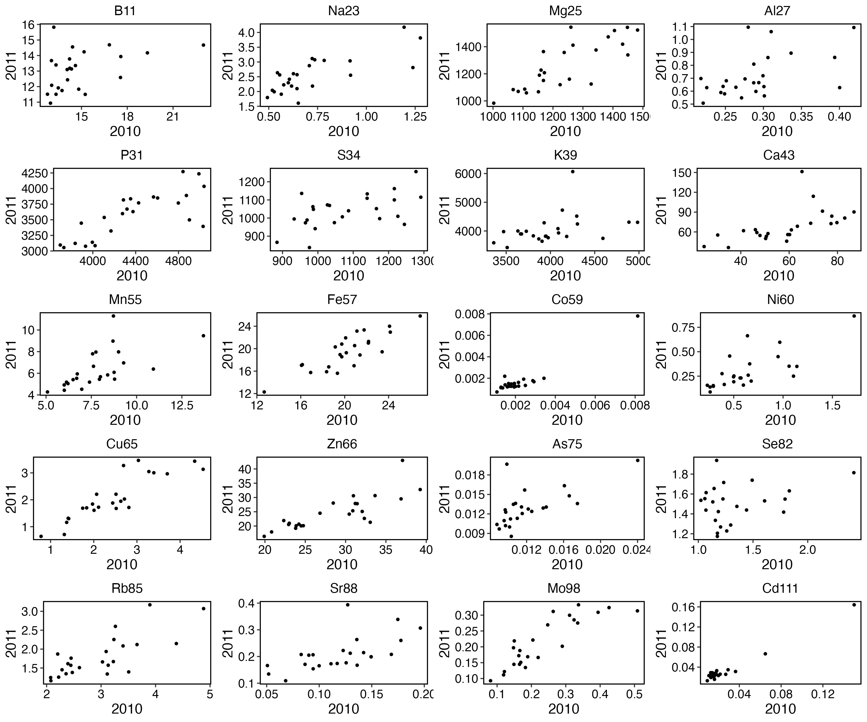
Additional figure 1

Slide 11
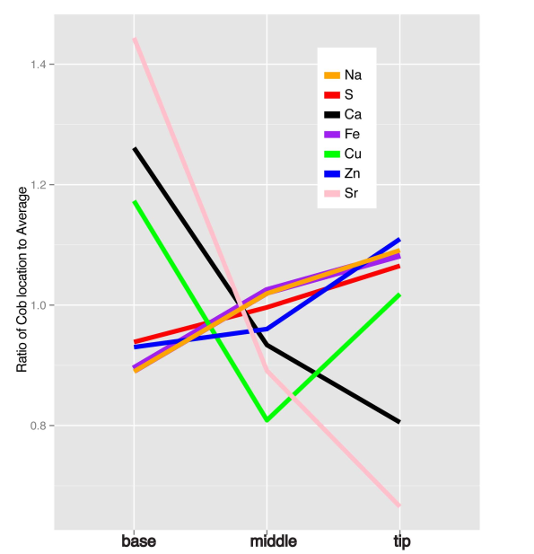
Figure 2- Original figure
Gradients in elemental accumulation along the cob
For each ear, the samples for each section were averaged and then normalized to the mean of the ear. The values for all ears were then averaged.
Only elements with significant effects of cob location were included in the model.

Slide 12
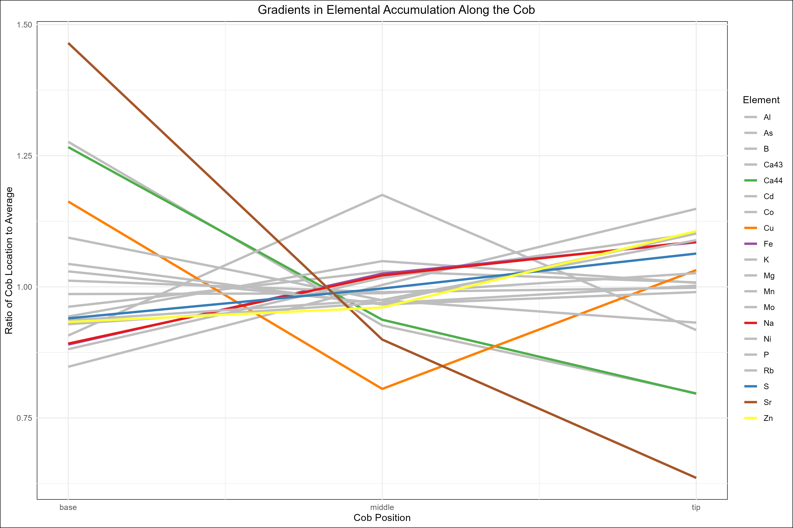
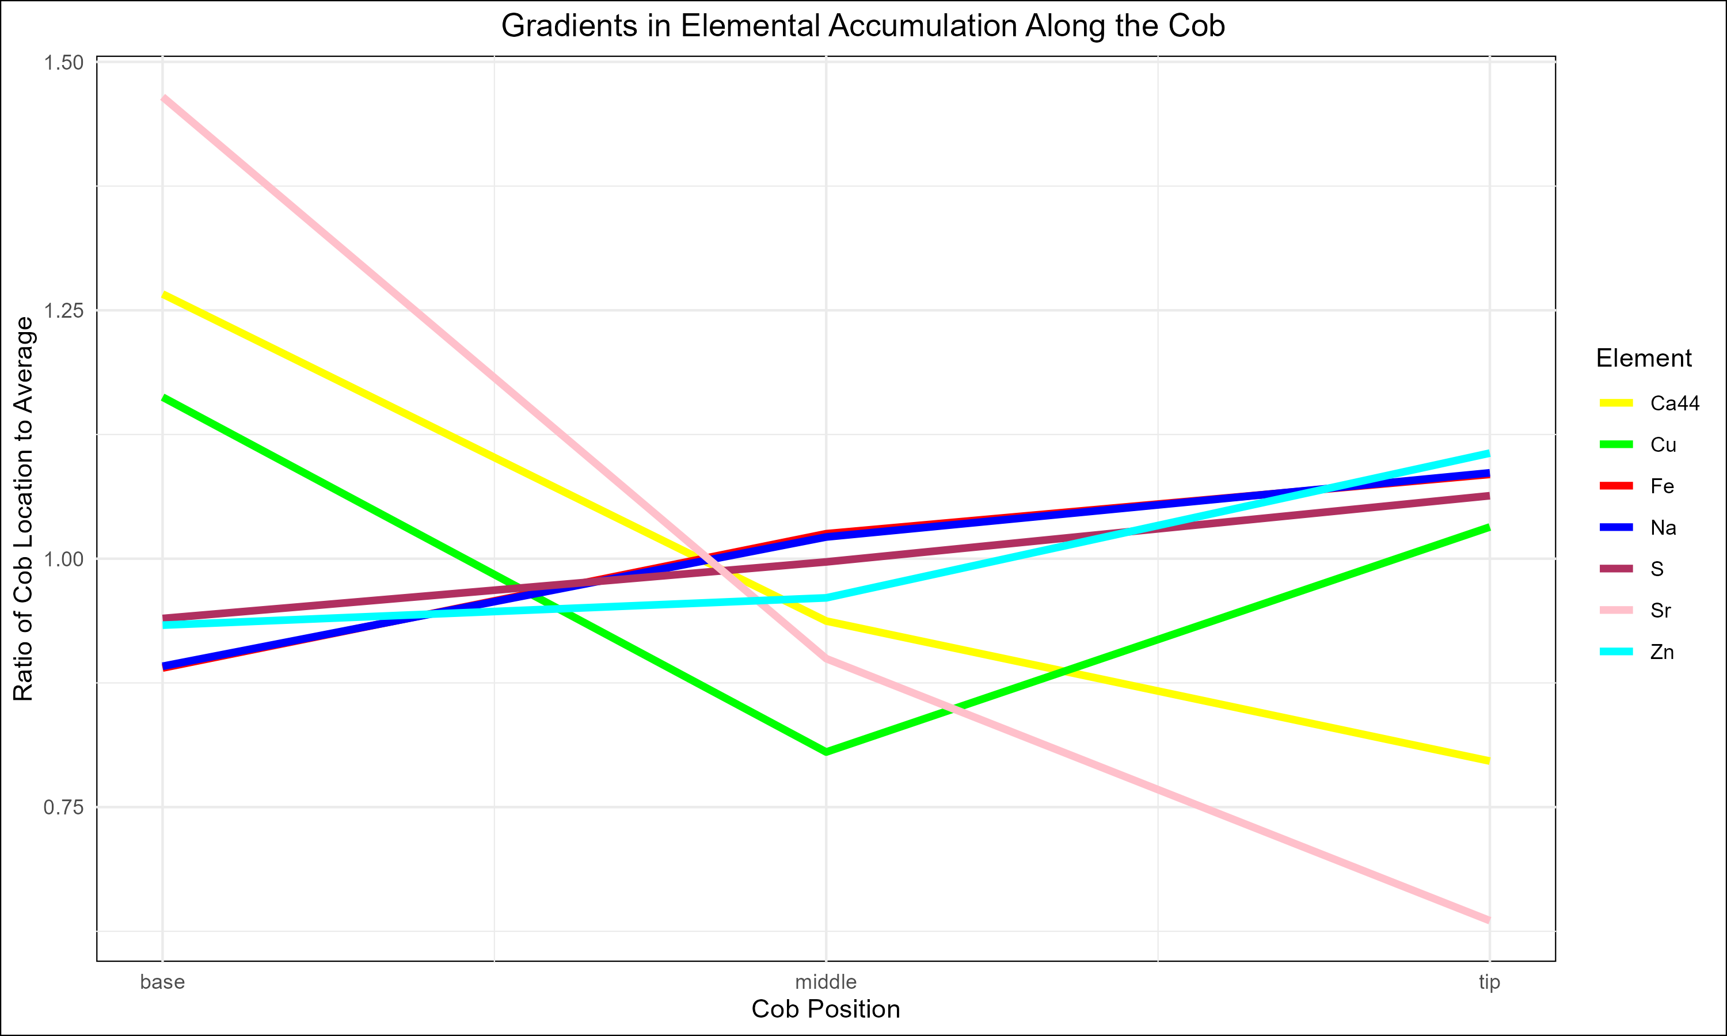
Figure 2

Slide 13
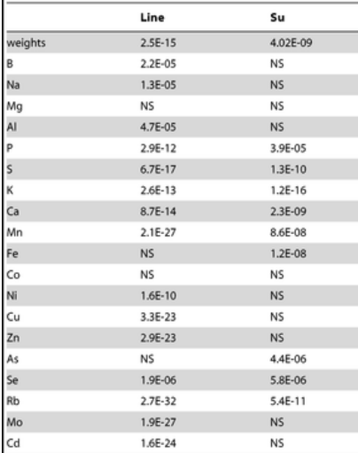
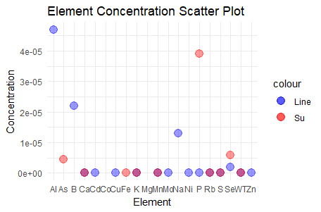
Table 3: Analysis of the sugary status on ionomic profiles.

Slide 14
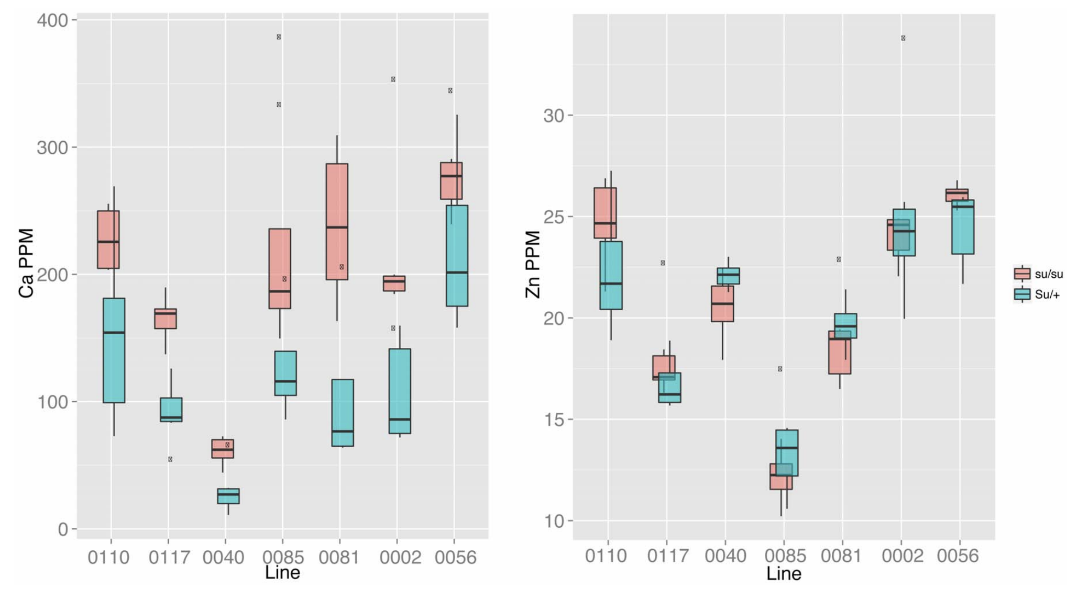
Figure 3 – original figure
Sugary kernels potentially lose water-soluble ions along with more stored carbon than wild-type
Some elements are in the embryo (Fe, Zn), while others (Ca, S) are in maternal tissue in the seed
To assess the impact of sugary on elemental composition, selected seven RI lines were selected

Slide 15
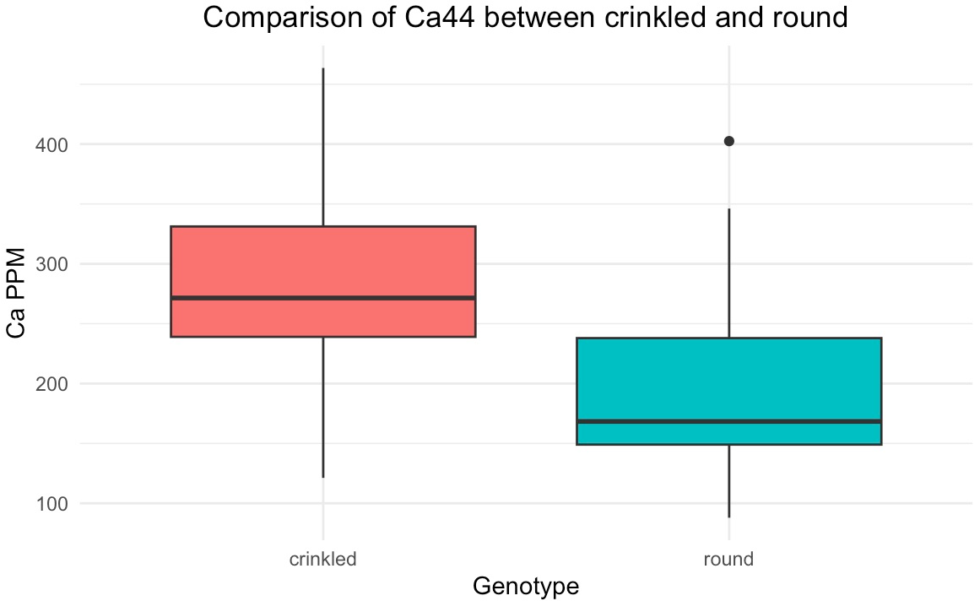
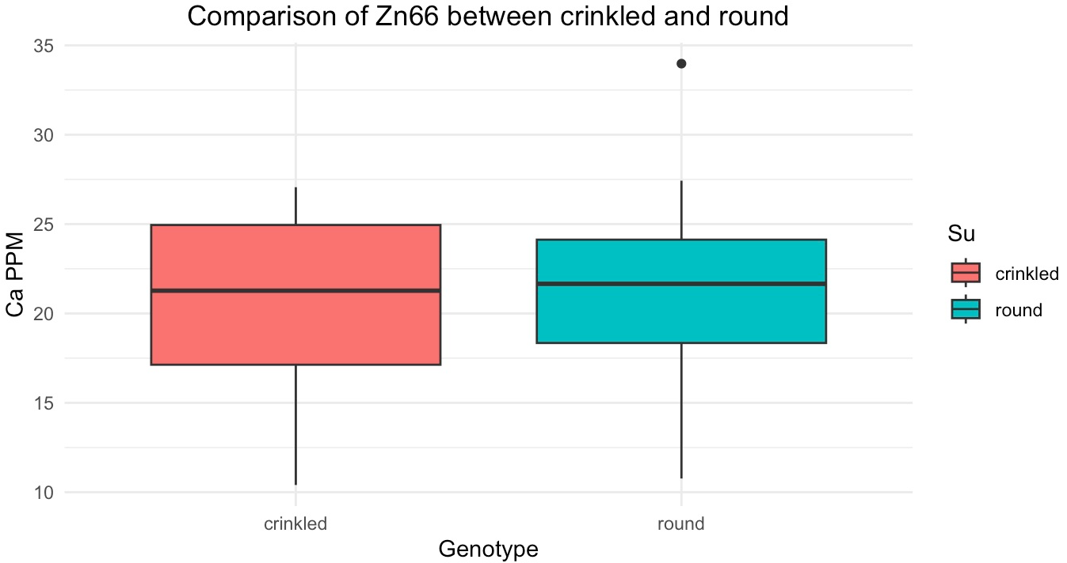
Figure 3 – su vs wild type
Boxplots of the effect su on Ca44 and Zn66 accumulation in the (B73_IL14H)S5 line

Slide 16
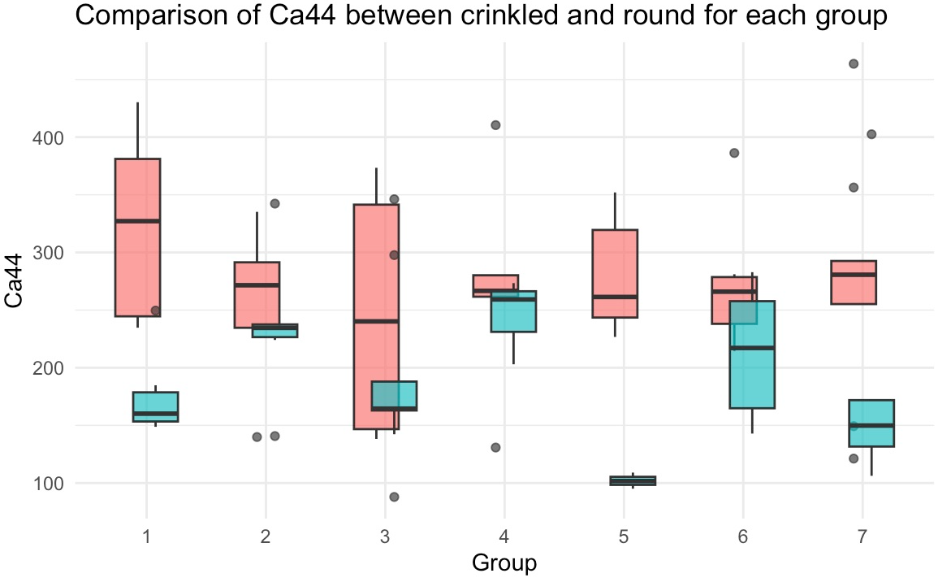
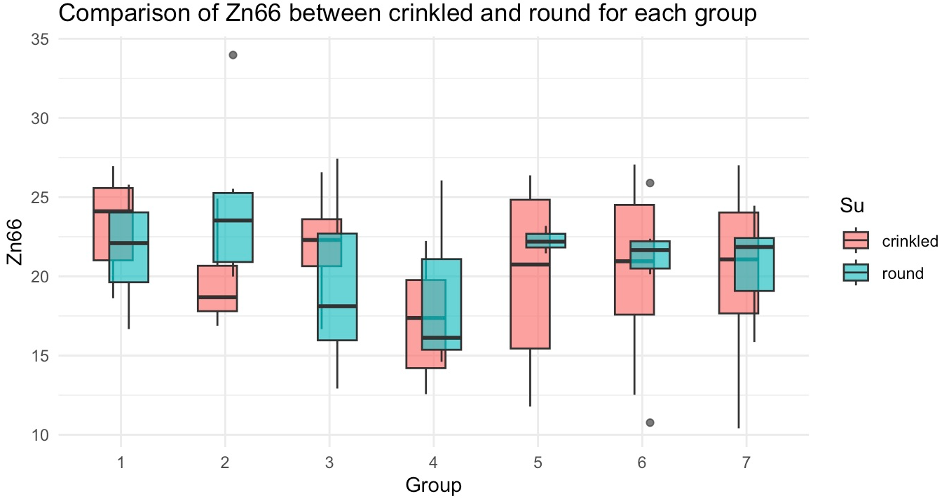
Figure 3
The data was filtered and divided into 7 groups randomly, and each group was assigned since the limitation information on the 7 lines

Slide 17
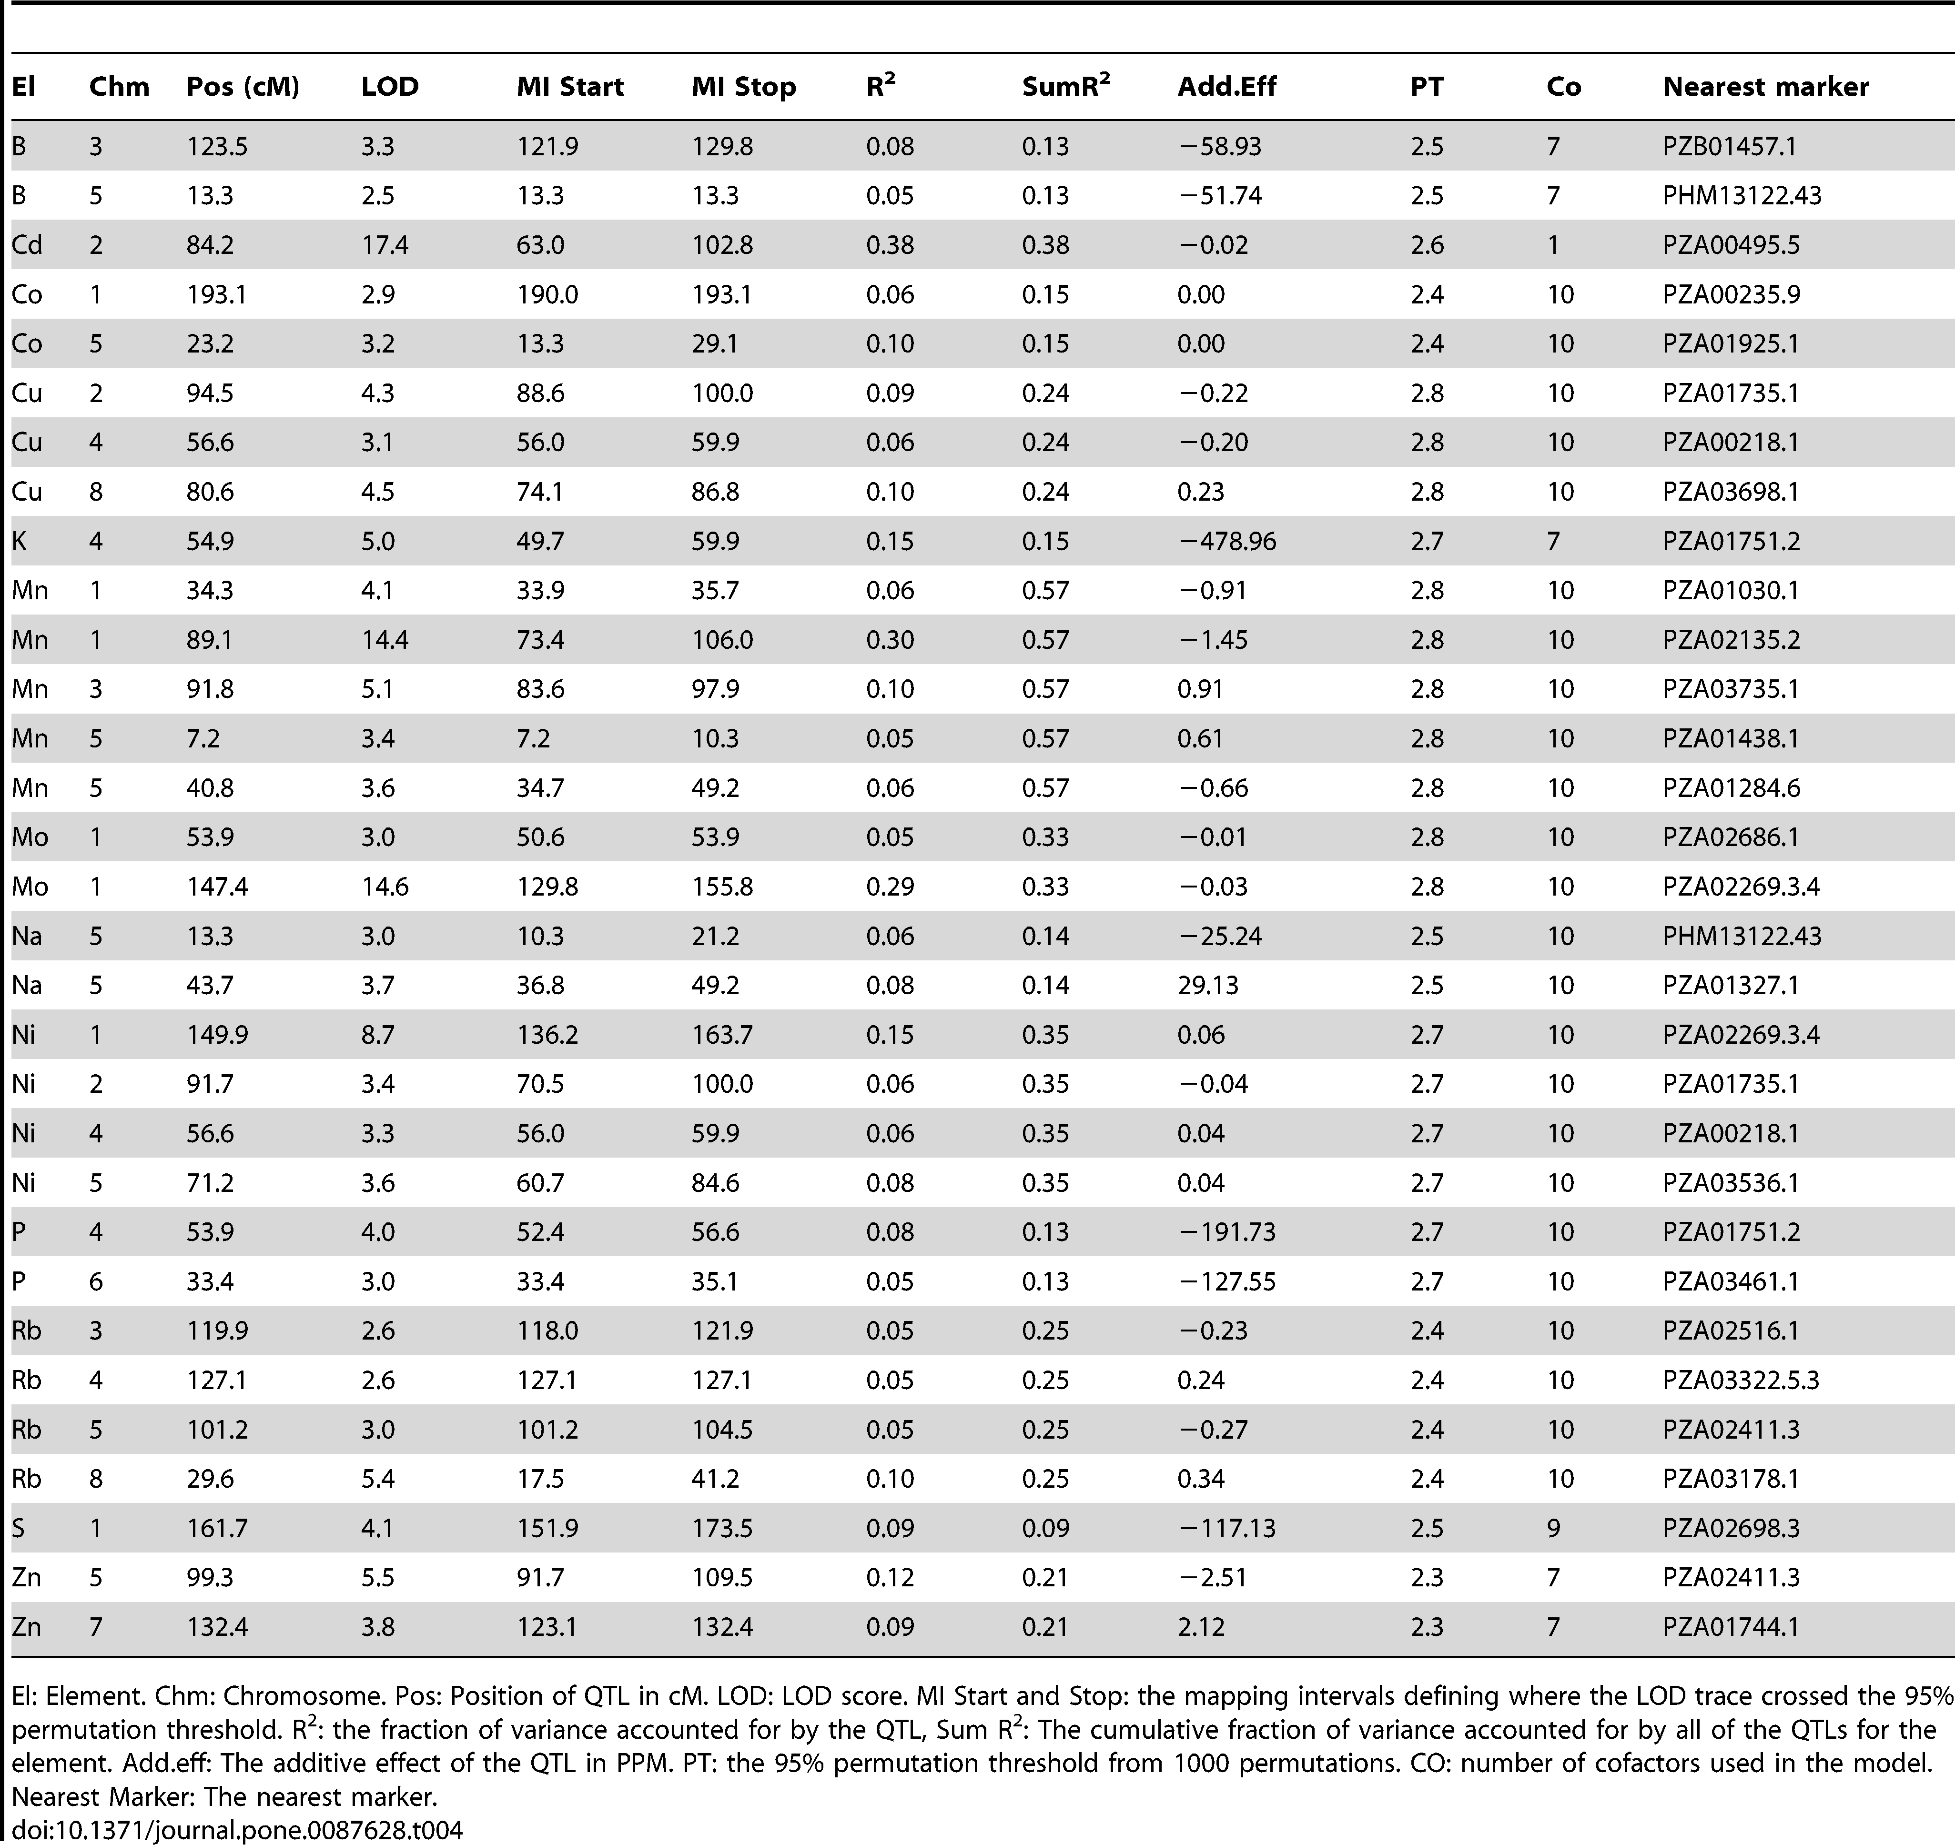
QTL analysis
Presented in tabular format in paper
Goal: generate visualizations for chromosome 1
Selected QTL with largest effect on chromosome 1 for recreation – sulfur (S)
El | Chr | Pos (cM) | Nearest Marker
S | 1 | 161.7 | PZA02698.3

Slide 18
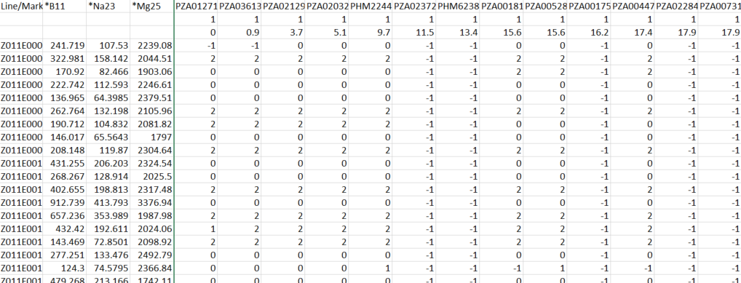
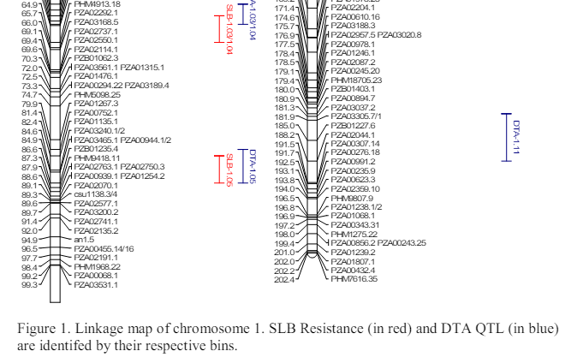
QTL analysis – preparation
Generate map and phenotype files in R
Includes phenotypic and SNPs for lines
Had marker names, not marker positions
Used thesis that published marker positions using same set of markers and manually entered positions in cM
Combine files
R/qtl package for qtl analysis
QTL scanning
QTL effect

Slide 19
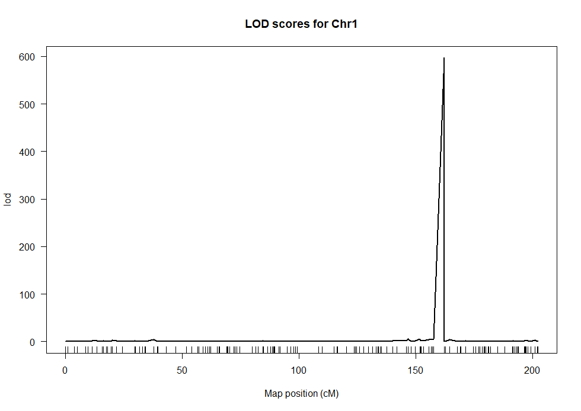
QTL scanning
QTL scan for chromosome 1
Marker = PZA03457.1
El | Chr | Pos (cM) | Nearest Marker
S | 1 | 161.7 | PZA02698.3
Note: Only scanning for sulfur on chromosome 1

Slide 20
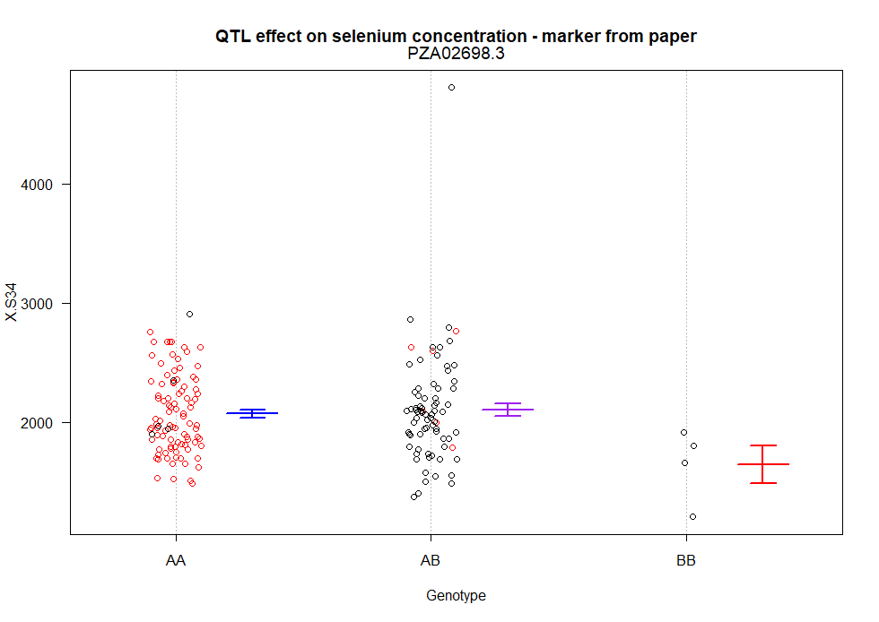
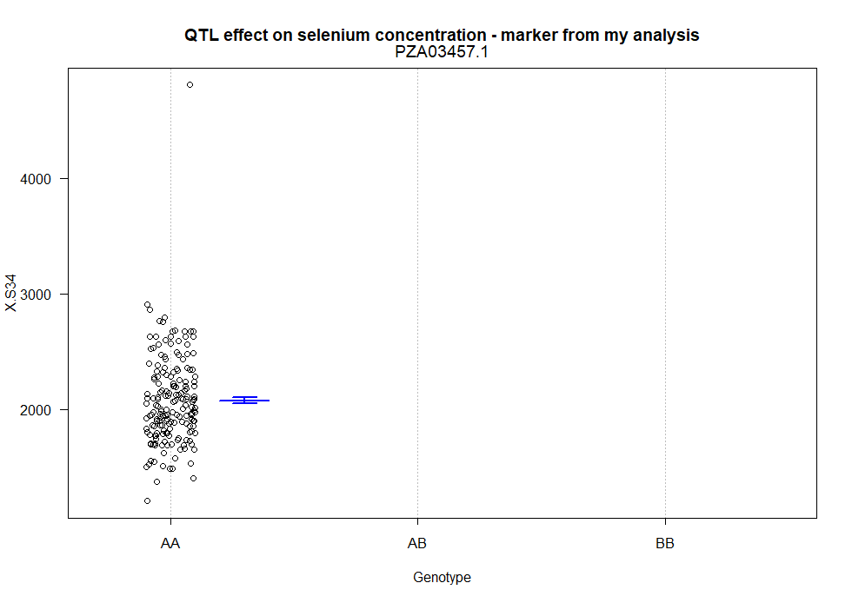
QTL effect
p = 9.838777 e-08
p = 0.004147716
In conclusion...would not recommend publishing these results. Reviewers may have a few questions

Slide 21

Documentation
https://github.com/rdgreene1/BCB546-Spring2024_FinalProject
Overarching README file explaining workflow for each analysis done
Each figure has documentation and comments within scripts

